Slide 1
Major Project Presentation
25S12 – Hardware Accelerator of BWFA-MEM2 on Alveo U50 using HLS
Guide: Prof. Kuruvilla Varghese
Students: Sri Sai Nomula, Sai Charan Katakam

Slide 2
Outline
Sequence Alignment
Manhattan Tourist Problem
Sequence Alignment is the Manhattan Problem in Disguise
Space-Efficient Sequence Alignment
High Level Synthesis
Profiling
Host Code Structure
Evolution of the design
Demo Setup
Project Specifications
Results
Comparisons

Slide 3
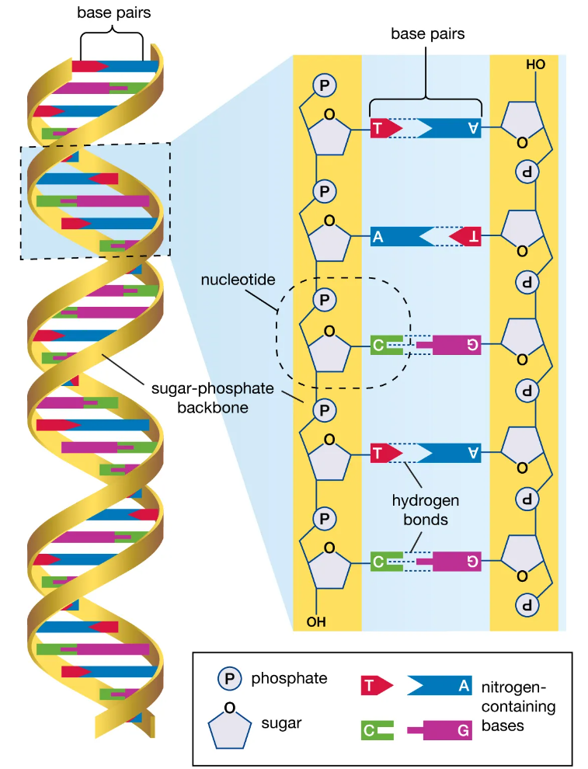
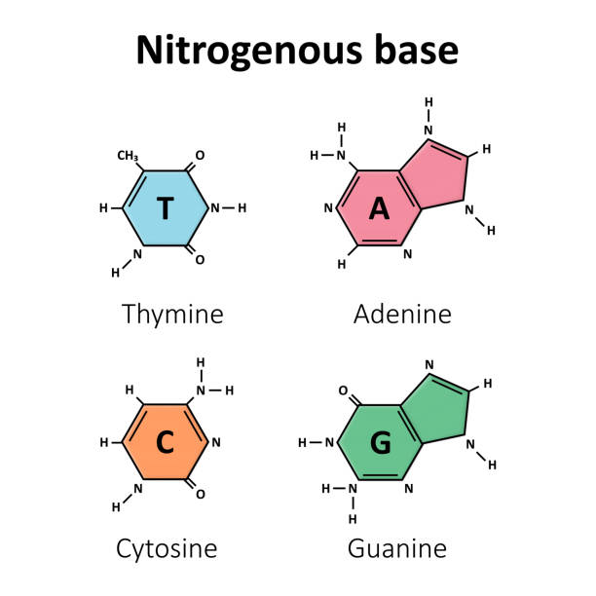
Origin of Sequences
DNA is made up of Nucleotides which are the basic building blocks. These Nucleotides are made up of 3 parts:-
Nitrogen-containing Base: Adenine (A), Thymine (T), Guanine (G) and Cytosine (C).
Sugar Molecules: Deoxyribose in DNA.
Phosphate Group
Figure 1: DNA Structure and Nitrogen-Bases [6]

Slide 4
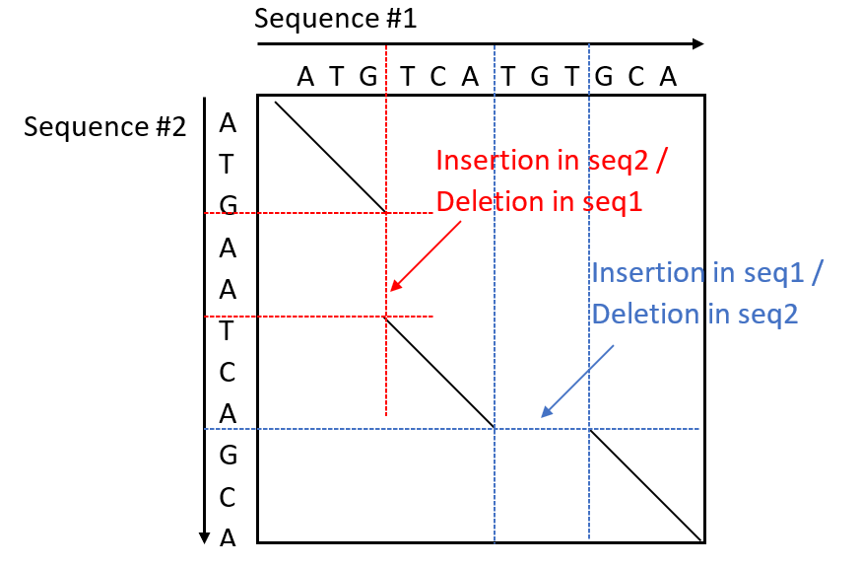
Sequence Alignment
(Text)
The aligned sequences have matches/mismatches, insertions and deletions.
Helps to identify similarities and evolutionary relationships between two DNA Sequences.
Developing new drugs and therapies based on protein targets.
Computational cost increases exponentially with increasing sequence lengths.
(Pattern)
Aligned sequences:
ATG - -TCATGTGCA
||| ||| |||
ATGAATCA- - -GCA

Slide 5
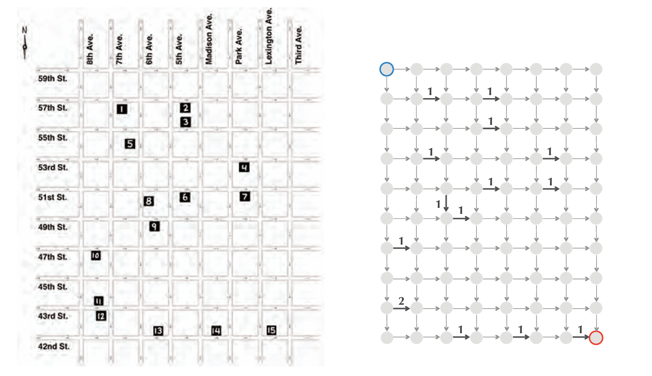
Manhattan Tourist Problem
The challenge of finding a legal path through the city that visits the most sights is called the Manhattan Tourist Problem. We will represent the map of Manhattan as a directed Manhattan Graph in which we model each intersection as a node and each city block between two intersections as a directed edge indicating the legal direction of travel ( or )
We then assign each directed edge a weight equal to the number of attractions along the corresponding block.
To solve the Manhattan Tourist Problem, we need to find a maximum-weight path connecting the source to the sink in Manhattan Graph.
Figure 2: Simplification of Midtown Manhattan [8]

Slide 6
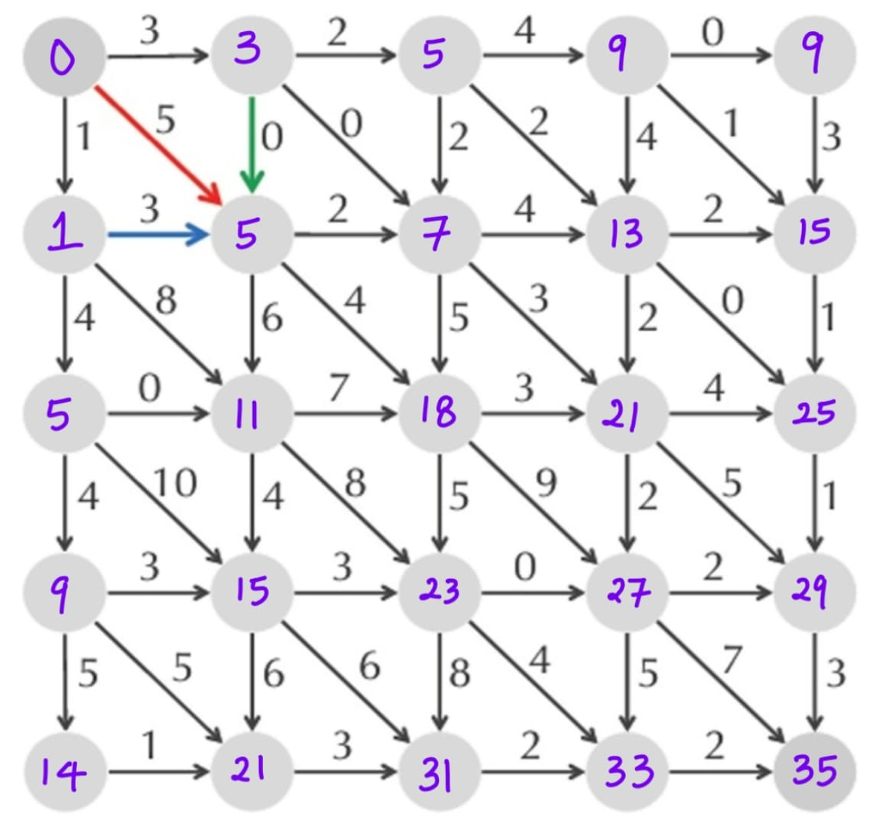
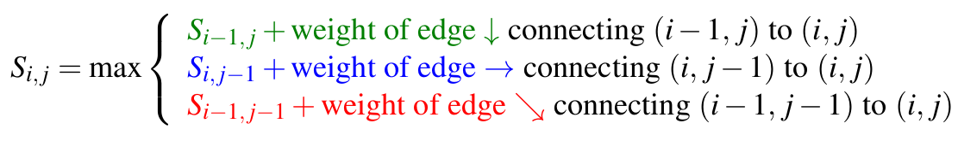
Sequence Alignment is the Manhattan Problem in Disguise
In addition to horizontal and vertical edges in Manhattan Tourist Problem, we have added diagonal edges connecting (i,j) to (i+1 , j+1) in Fig.3 .
Finding a longest common subsequence of two strings is equivalent to finding an alignment of these strings maximizing the number of matches.
To compute scores for any node (i,j) of this graph, we use the following recurrence:
Figure 3: Calculation of Maximum Length Path to go from Source to Sink

Slide 7
Space-Efficient Sequence Alignment
The runtime of the dynamic programming algorithm for aligning two strings of lengths n and m is proportional to the number of edges in their alignment graph, which is O(nm). The memory required is also O(nm).
A divide-and-conquer algorithm often works when a solution to a large problem can be constructed from solutions of smaller problem instances. The divide phase splits a problem instance into smaller instances and solves them; the conquer phase stitches the smaller solutions into a solution to the original problem.
The idea of space reduction technique works in following steps:
  Finding Middle Node of the Alignment.
  Computing Alignment Score in Linear Space.

Slide 8
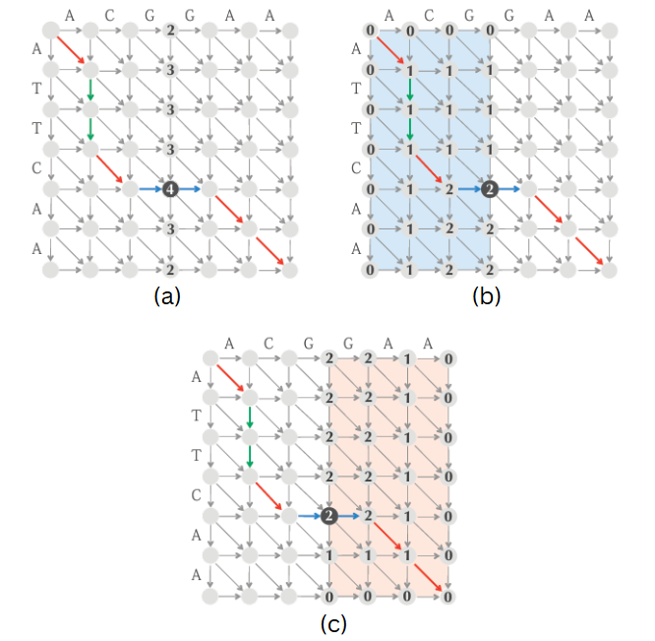
Finding Middle Node of the Alignment
Given Strings v = v₁ , v₂ …, v_{n} and w = w₁ , w₂ …, w_{m} define middle = m/2. A longest path from Source to Sink in the alignment graph must cross the middle column somewhere, and our first task is to figure out using only O(n) memory.
In Figure 4(a), we calculated middle = 3 (⌊m / 2⌋), and the alignment path crosses the middle column at the (unique) middle node (4,3) which has highest score in that column i.e., 4. Let FromSource(i) denote the length of the longest path from the source (0,0) to ending at (i,middle) and ToSink(i) denote the length of the longest path from (i,middle) to the sink (n,m).
Length(i) = FromSource(i) + ToSink(i)
Figure 4: Finding Mid Node based on two Scores
i.e., FromSource(i) and toSink(i).

Slide 9
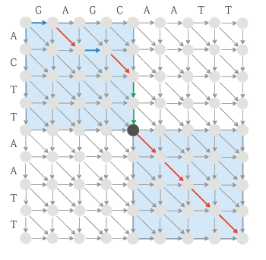
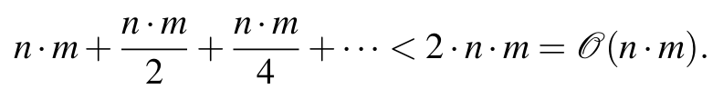
The Fast and Memory-Efficient Alignment Algorithm
Once we have found a middle node, we automatically know two rectangles through which a longest path must travel on either side of this node. As shown in Fig.6, one of these rectangles consist of all nodes above and to the left of the middle node, whereas the other rectangle consists of all nodes below and to the right of the middle node. Thus, the area of the two highlighted rectangles is half the total area of the alignment graph.
We can now divide the problem of finding the longest path
from (0,0) to (n,m) into two subproblems i.e., Finding a
longest path from (0,0) to the middle node and finding a longest path from the middle node to (n,m).
Proceeding in this way, we will find middle nodes of all rectangles in time equal to,
Figure 5: Divide and Conquer Approach to find the Optimal Alignment.

Slide 10
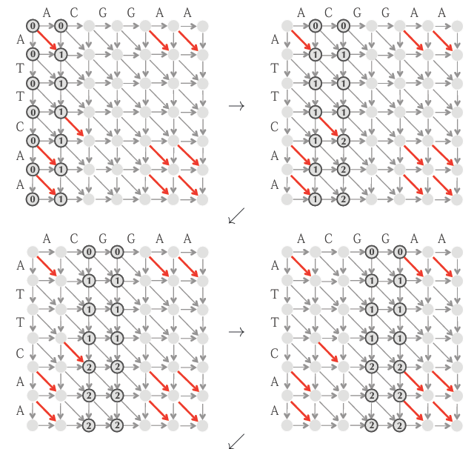

Computing Alignment Score in Linear Space
The space required can easily be reduced from the observation that only values needed to compute the alignment scores in column j are the alignment scores in column j-1. Therefore, the alignment scores in the columns before columns j-1 can be discarded when computing the alignment scores for column j, as illustrated in Fig 6.
Figure 6: Computing Alignment Scores in Linear Space

Slide 11
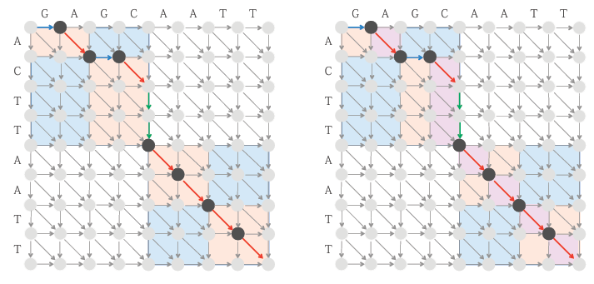

Thus, we have arrived at a linear-time alignment algorithm that requires only linear space.
Figure 7: Finding Middle Nodes within previously identified rectangles.

Slide 12
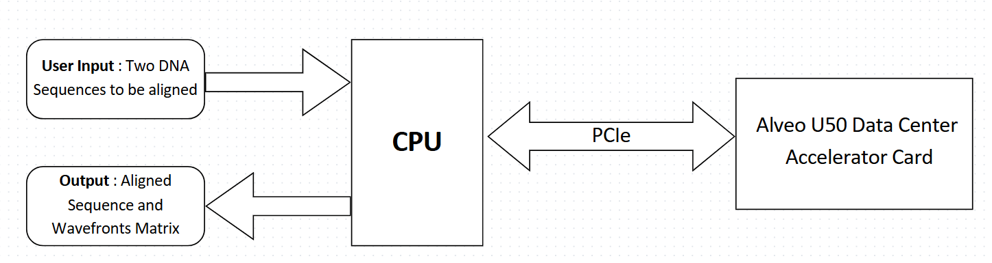
Aim of the Project
Design a data center card-based accelerator for the Bi-WFA algorithm.
The computation of scores and junctions are done in the Alveo U50 and using this data, rest of the alignment is computed in the host CPU.
Figure 8: Expected Demo setup.

Slide 13
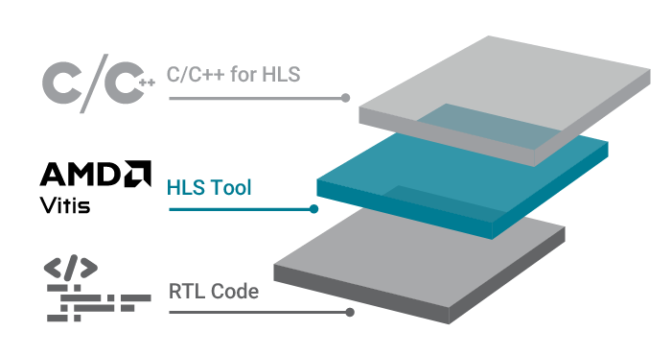
High-Level Synthesis (HLS)
High-Level Synthesis (HLS) is a technology that converts high-level behavioral descriptions of hardware into Register-Transfer Level (RTL) models. Thus, it drastically reduces the design effort and leads to faster time to market.
C / C++ Constructs | HW Components
Functions | Modules
Arguments | IO ports
Operators | Functional units
Scalars | Reg / Wires
Arrays | Memory
Control flows | Control logic
Figure 9: HLS Flow [9].
Table 1: C++ constructs vs HW components.

Slide 14
Role of Pragmas in HLS
In Vitis HLS, pragmas serve as crucial directives or hints that empower the synthesis tool to translate high-level C++ code into efficient RTL hardware descriptions. They will give the following advantages,
Latency Reduction: Specific pragmas can minimize the number of clock cycles needed to execute operations, thereby reducing latency and improving responsiveness.
Throughput Performance: Using appropriate pragmas, we can maximize data processing rates, enhancing the overall throughput of the design.
Area and Resource Usage: Pragmas provide mechanisms to manage and reduce the utilization of FPGA resources, ensuring that the design remains within the specified constraints of the target device.

Slide 15
Different Pragmas used in our design
#pragma HLS pipeline: The pipeline pragma in Vitis HLS is used to optimize and enhance the performance of loops or functions by reducing the initiation interval (II), thereby allowing concurrent execution of operations.
Initiation Interval (II):- Represents the speed at which a circuit can accept new inputs.
#pragma HLS Array Partition: The array partition pragma is used to partition an array into smaller arrays or individual elements to improve parallel access and performance. By using this pragma, we can reduce the access bottleneck and increase throughput, which is especially beneficial for performance critical components.
#pragma HLS loop_tripcount: This pragma is used to help the HLS compiler optimize loops when the loop bounds are not statically known.
#pragma HLS interface: The interface pragma is used to specify the interface properties of the function. It informs the tool about the interaction between the function and the rest of the system, including how data is transferred in and out of the function.

Slide 16
Non-Synthesizable Constructs of C/C++
A software which is well optimized for a CPU cannot be used directly for an FPGA, at least not before it is thoroughly checked, all the non-synthesizable parts of the code are replaced with the synthesizable counterparts. Usage of such constructs may cause issues during the design process. Here are few of them:
System Calls: ‘printf()’, File operations such as ‘open()’ ,'read()' etc.
Use of Dynamic Memory: All memory allocation must be static or predetermined at compile time. Functions like ‘malloc()’, ‘free()’ are examples of dynamic memory usage that must be avoided.
Recursive Functions: Recursion leads to indeterminate stack size and is not synthesizable. Loops or iterative equivalents must be used instead.
Pointer Limitations: Pointers are allowed but heavily restricted: No pointer arithmetic (like ptr++, ptr += n), No function pointers or arrays of pointers.

Slide 17
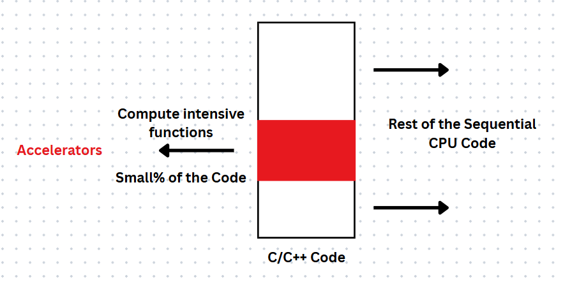
Hardware Acceleration
Hardware Acceleration refers to the use of specialized hardware to perform certain computing tasks more efficiently than general-purpose CPUs. It speeds up specific functions by offloading them to dedicated hardware components.
First, we should find parts of the application that can benefit from the FPGA structure to run faster on FPGA than on the CPU. This process is called software-hardware partitioning.
Figure 10: Representation of Hardware Acceleration

Slide 18
Profiling the C++ Code
Profiling an application and finding the compute-intensive parts is one of the most important steps in improving performance. It is achieved by instrumenting either the program source code or its binary executable form using a tool called profiler. Valgrind, Gperf tools from Google and Gprof the classical gcc profiling tool are some tools used for profiling. Gperf tool is a CPU profiler that software developers use in Google. Main goal of this tool is to measure and compare the execution time of different functions in a software application.
gprof a.out gmon.out —gprof2dot— dot-Tpng-o out.png: This generates the profiling report (gprof a.out gmon.out), converts that into a graph (gprof2dot) and renders it as a png image using Graphviz (dot-Tpng) and then saves the image (-o out.png).

Slide 19
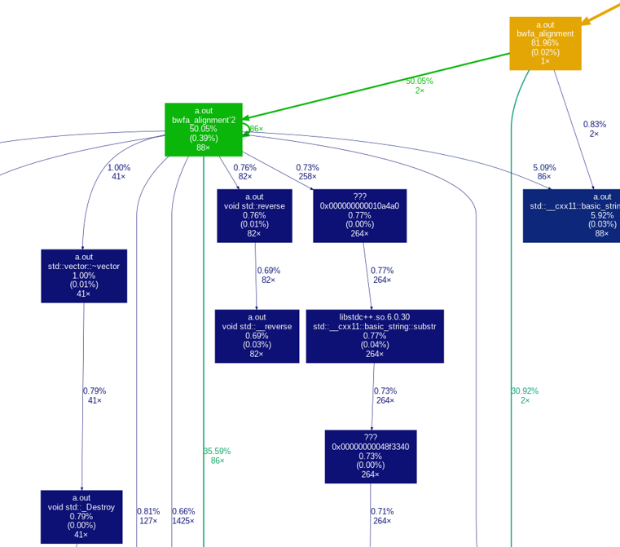
Analyzing the output of Profiler
50.05% of the total time (cumulative time including child calls) was spent inside bwfa alignment’2 function.
0.39% is the self-time (time that is actually spent inside bwfa alignment itself).
88x means this function was called 88 times.
The edges from bwfa alignment’2 represents the amount of runtime accounted for and the number of calls. Example, the edge with 2.75% and 41x represents that this edge accounted for 2.75% of runtime across 41 calls.
Figure 11: Analysing the part of profiler output

Slide 20
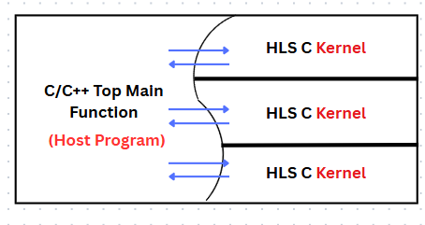
Program Structure
The C/C++ top function or host program runs on the available processor and a couple of accelerators or kernels run on FPGA. The host is responsible for managing the execution of the kernel.
The kernel source code runs on accelerator hardware uses high-level synthesis and converts the C/C++ code into the equivalent RTL code. The host program will use vitis runtime system (XRT) APIs to communicate with the kernels.
Figure 12: General Form of program structure

Slide 21
Vitis Implementation

Slide 22
Host Code Structure
The Host code can be divided to three parts each with their own significance.
Setting up the Environment
  Includes required libraries.
  Sets design parameters MAX_SEQ_LEN, TOTAL_KERNELS.
Core Commands
  Loading the FPGA Device
  Reading DNA Sequences
  Buffer Allocation
  Kernel Setup
  Kernel Execution
Post-Processing
  Kernel Execution Timing
  Fetching Aligned Sequences
  Displaying Results

Slide 23
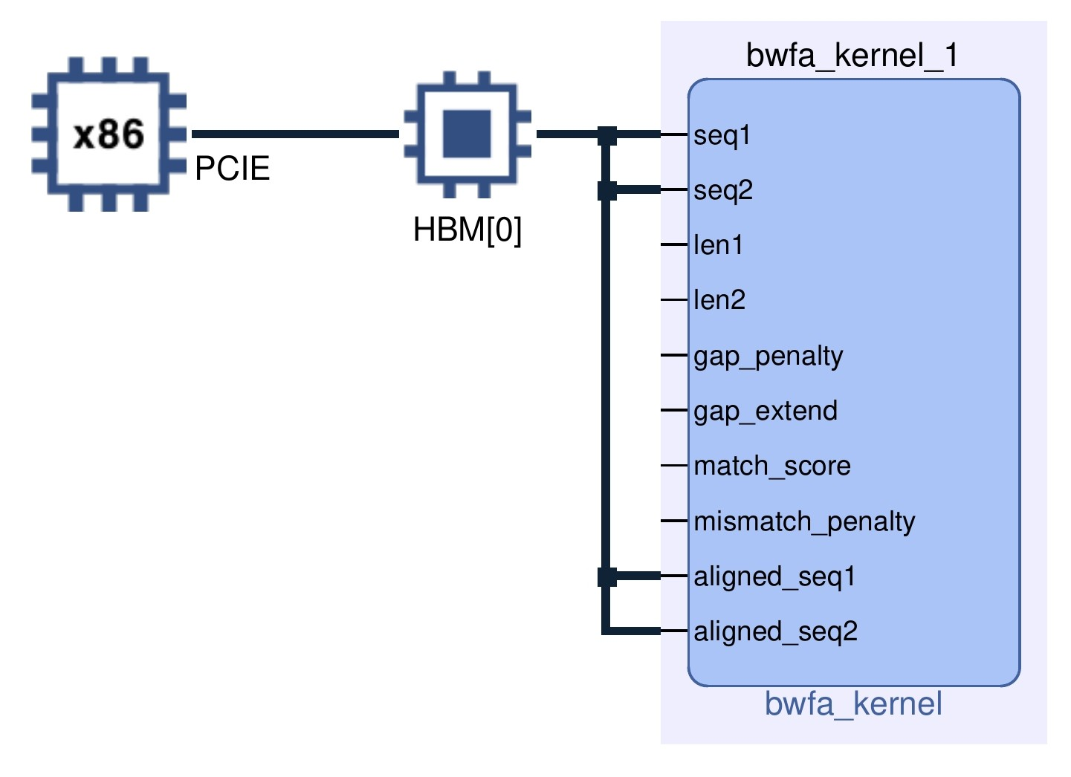
Evolution of the design
Version 1: Basic design with single kernel and single High Bandwidth Memory (HBM) for sequence alignment.
Version 2: Enhanced user experience with single kernel. Like printing the steps the program is going through in the command window etc.
Version 3: File-based input handling with error handling and calculation and printing the execution times.
Figure 13: Version-1

Slide 24
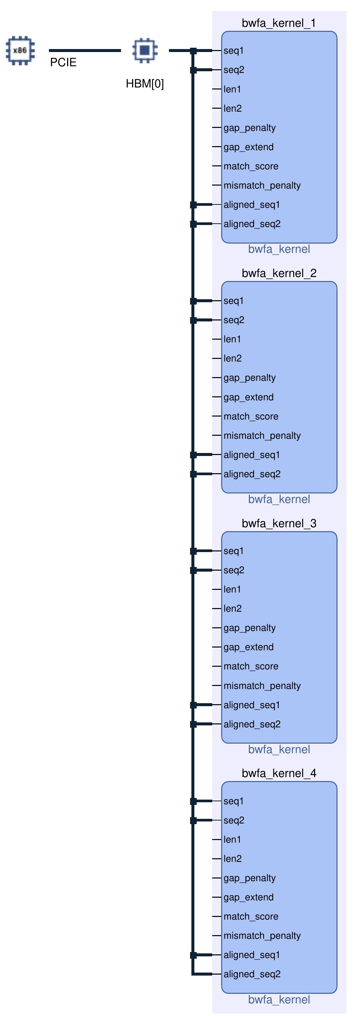
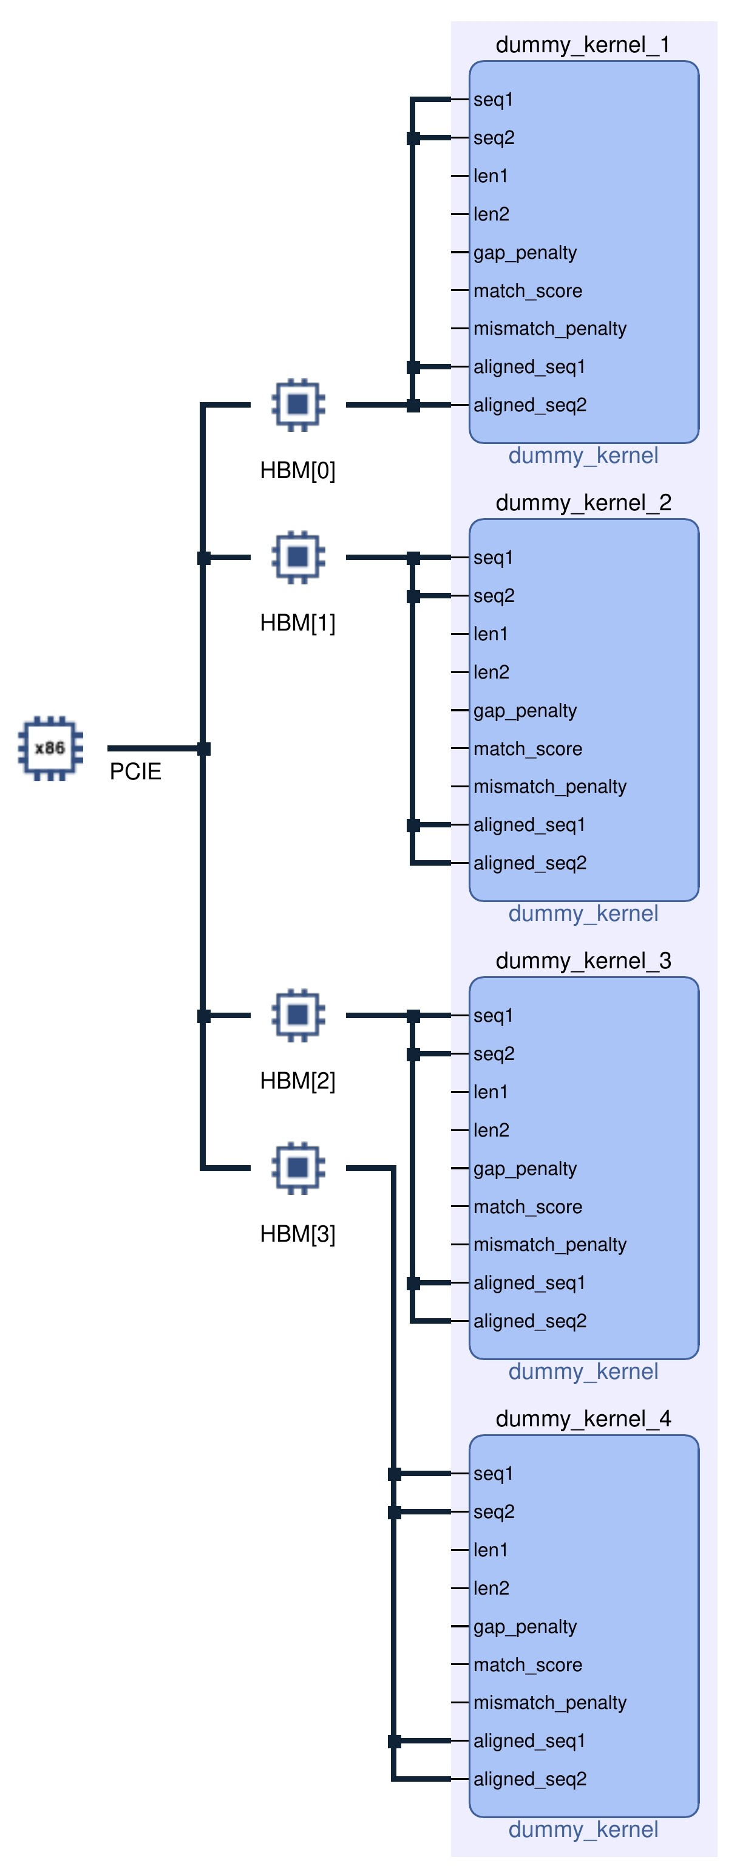
Evolution of the design
Version 4: Parallel processing with multiple kernels and single high bandwidth memory (HBM). With usage of only kernels which are required.
Version 5: Multi-kernel and iterative design for any length sequence with separate HBM for each kernel.
Figure 14: Version-4
Figure 15: Version-5

Slide 25
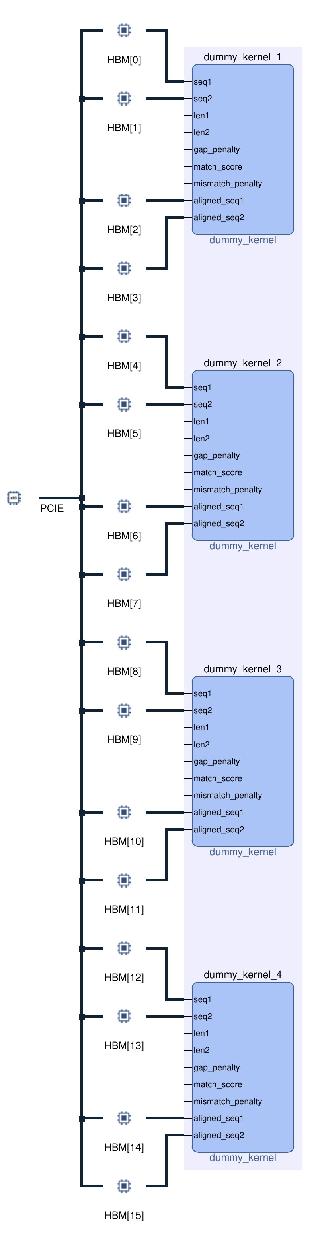
Evolution of the design
Version 6: Improved Performance and Memory Optimization by allocating different HBM's for different inputs reducing contention and dependencies.
Figure 16: Version-6

Slide 26
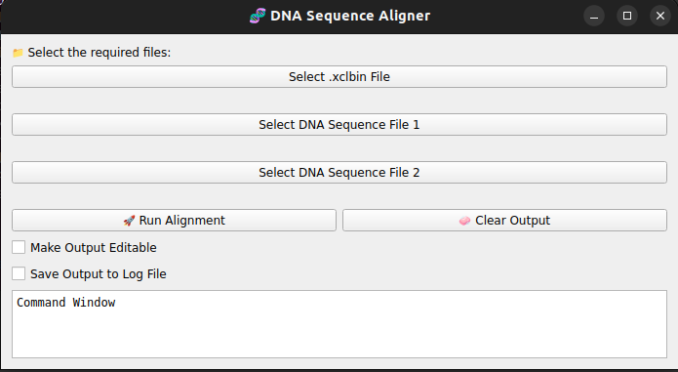
Evolution of the design
Version 7: Done High-performance optimizations for speed and efficiency via Vitis tool.
Version 8: Replaced Dynamic buffer allocation with static Buffer allocation for faster execution.
Version 9: Integrated the implemented design with GUI made using Python 3 for user-friendly experience.
Figure 17: Version-9

Slide 27
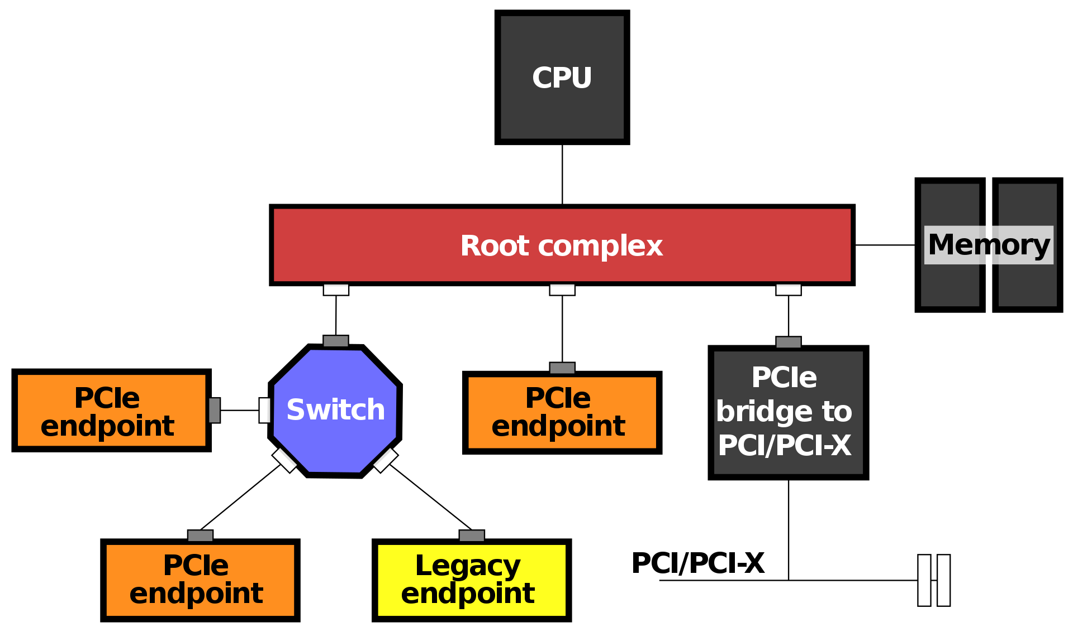
Interface
Here the interface between Host and FPGA uses the Direct Memory Access (DMA) through PCIe. By using DMA, the FPGA, which is a PCIe endpoint in the topology can transfer the data without intervention of CPU at very high speeds.
Figure 18: PCI Express topology [10].

Slide 28
Kernel Code Structure
The Kernel code can be divided to three parts with their own significance.
Setting up the Environment
  Includes required libraries.
Needleman-Wunsch Scoring Function
  Calculation of the dynamic programming matrix.
  Compares possible outcomes such as match, mismatch, insertion or deletion.
  selects the best alignment score for each pair of characters in the sequences.
BWFA Alignment Function
  Splits the sequences into smaller segments
  Computes the alignment in parallel, reducing the overall time complexity. It performs recursive alignment until the sequences are small enough.

Slide 29
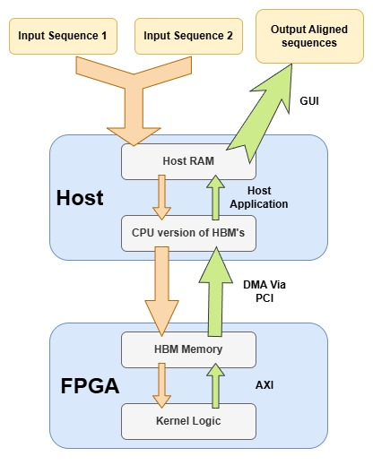
Demo Setup
User provides paths to two DNA sequence files via CLI/GUI, which are loaded into host memory.
Host allocates device buffers using XRT APIs Buffer Objects mapped to designated HBM banks on the FPGA.
Input sequences are chunked (max 64 bases) and copied into these mapped buffers, followed by synchronization.
Host initiates DMA via PCIe transfer of data to FPGA.
Each compute kernel reads its input from HBM, performs pairwise alignment using defined scoring, and writes results to output buffers.
Output buffers are synced back to the host with DMA.
Host aggregates all aligned chunks and prints the final output, recording execution times for profiling.
Figure 19: Demo Setup.

Slide 30
Project Specifications
Software Specifications
Sequences to be aligned – DNA Sequences
Length of reads – Any length
Alignment type – Global
Input format – String of two DNA sequences
Output format – String of aligned sequences
User interface – Command Line Interface and Graphical User Interface
Hardware Specifications
Alveo U50 Data Center Accelerator Card
Host Server Running Linux
Software interface – PCIe Gen4 interface
Table 2: Project Specifications

Slide 31
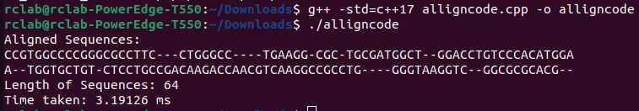
Alignment Using Software (CPU only)
The C++ code has been saved as alligncode.cpp, it is compiled using g++ compiler to generate the alligncode.o file which when executed using ./alligncode will run in command window performing the sequence alignment and display the aligned sequences.
Figure 20: Alignment using software.

Slide 32
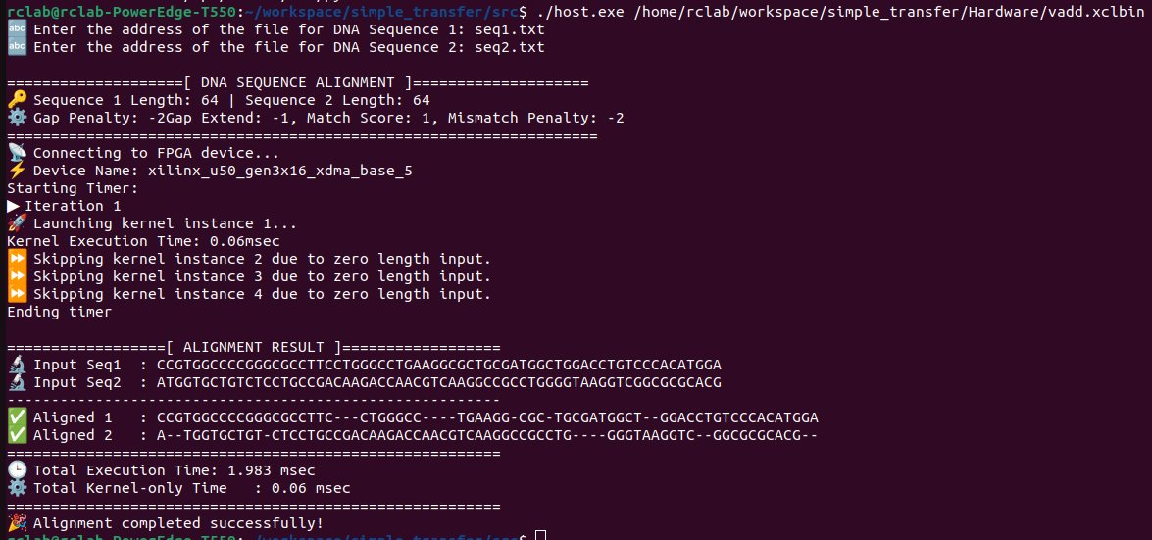
Alignment Using Hardware (CPU + FPGA)
The Hardware designed for sequence alignment has run on terminal and the aligned sequences along with the various input parameters and steps in hardware execution are printed in the command window.
Figure 21: Alignment using Hardware (CLI).

Slide 33
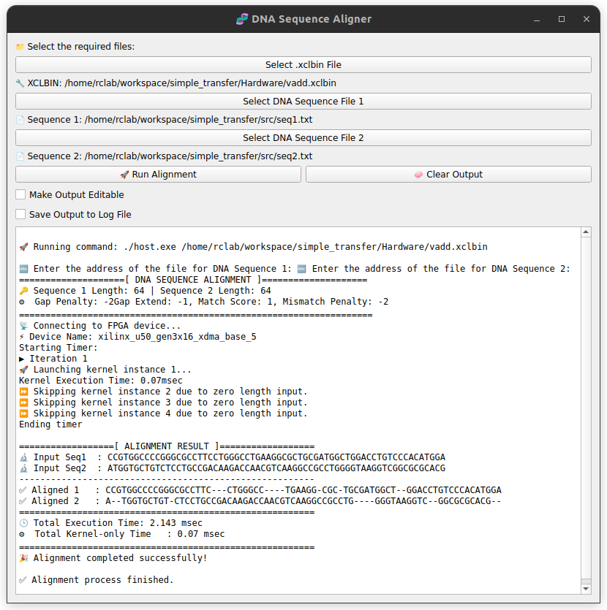
Alignment Using Hardware (CPU + FPGA)
The Hardware designed for sequence alignment has run using GUI which allows us to select the individual text files via file system for easier usability and faster analysis and the aligned sequences along with the various input parameters and steps in hardware execution are printed in the command window.
Figure 22: Alignment using Hardware (GUI).

Slide 34
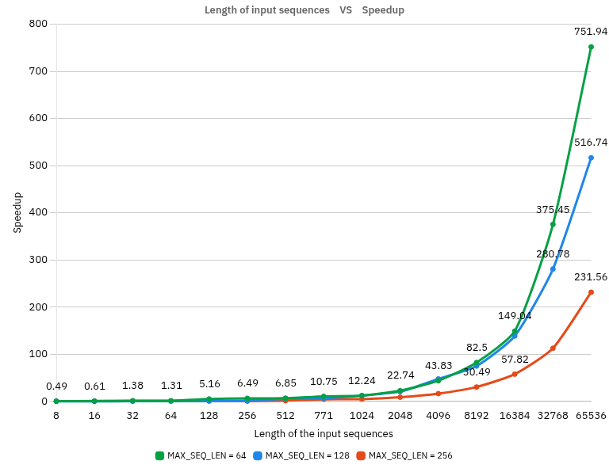
Performance Analysis (Length Vs Speedup)
Multiple simulations were performed by changing the design factor MAX_SEQ_LEN of a base kernel as 64, 128 and 256 with input sequences of different lengths from 8 to 65536, Hardware and Software times were calculated and plotted.
Here each data point corresponds to number of times hardware aided design is better than CPU only based design. For the length of base kernel MAX_SEQ_LEN = 64, the performance is the best as compared to other base kernel lengths.
Figure 23: Length of input sequences Vs Speedup.

Slide 35
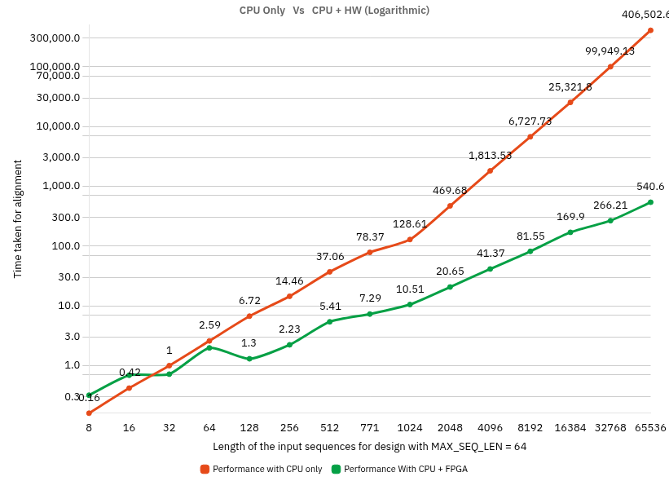
Performance Analysis (HW Vs SW)
For MAX_SEQ_LEN = 64, both hardware and software times are measured for input sequences of various lengths and plotted. As the deviation between them is too high, we cannot get the detailed information in a linear plot, hence we used a logarithmic plot. Each data point in the plot corresponds to the time taken to align sequences in milliseconds.
Figure 24: CPU Only performance Vs CPU + FPGA performance

Slide 36
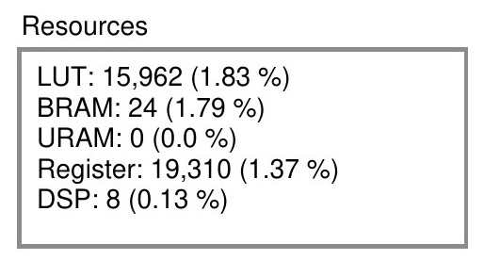
Resource Utilization
The following table shows the resource utilization for each kernel instance. The figure shows the resource utilization per kernel and their percentages compared to total available resources.
Name | Kernel | LUT | Register | BRAM | URAM | DSP
bwfa kernel 1 | bwfa kernel | 15,962 | 19,310 | 24 | 0 | 8
bwfa kernel 2 | bwfa kernel | 15,962 | 19,310 | 24 | 0 | 8
bwfa kernel 3 | bwfa kernel | 15,962 | 19,310 | 24 | 0 | 8
bwfa kernel 4 | bwfa kernel | 15,962 | 19,310 | 24 | 0 | 8
Figure 25: Resources per Kernel.
Table 3: Resource Utilization Summary for Each Kernel Instance.

Slide 37
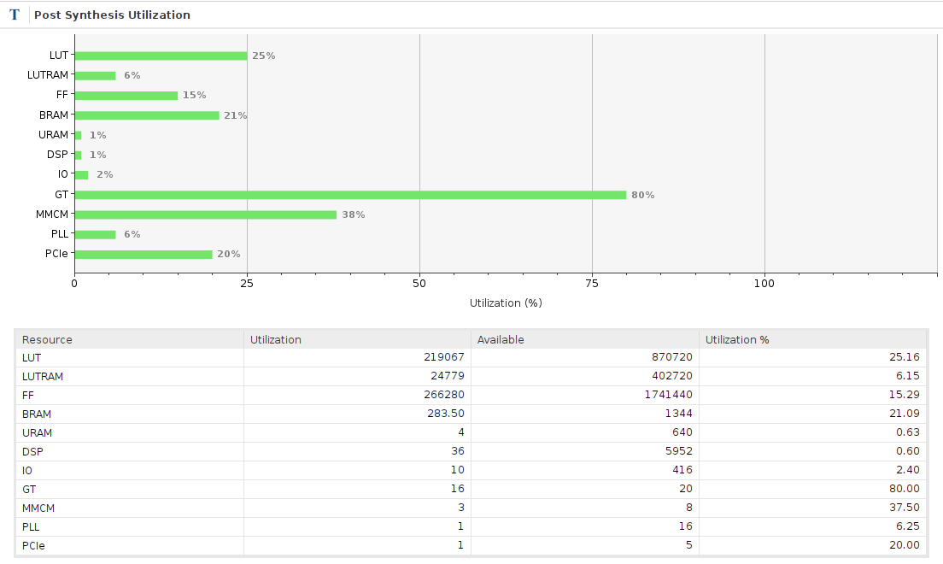
Post Synthesis Utilization Summary
Resource | Utilization | Available | Utilization %
LUT | 219067 | 870720 | 25.16
LUTRAM | 24779 | 402720 | 6.15
FF | 266280 | 1741440 | 15.29
BRAM | 283.5 | 1344 | 21.09
URAM | 4 | 640 | 0.63
DSP | 36 | 5952 | 0.60
IO | 10 | 416 | 2.40
GT | 16 | 20 | 80.00
MMCM | 3 | 8 | 37.50
PLL | 1 | 15 | 6.25
PCIe | 1 | 5 | 20.00
Figure 26: Post Synthesis Utilization.
The post synthesis utilization summary of the implemented design is shown in Figure 26.

Slide 38
Timing Estimate
Various kernel instances, their Target frequency and Estimated frequency is generated by the tool and shown in table 4.
Compute Unit | Kernel Name | Module Name | Target Frequency (MHz) | Estimated Frequency (MHz)
bwfa kernel 1 | bwfa kernel | bwfa alignment | 300.300 | 411.015
bwfa kernel 1 | bwfa kernel | bwfa_kernel | 300.300 | 411.015
bwfa kernel 2 | bwfa kernel | bwfa alignment | 300.300 | 411.015
bwfa kernel 2 | bwfa kernel | bwfa_kernel | 300.300 | 411.015
bwfa kernel 3 | bwfa kernel | bwfa alignment | 300.300 | 411.015
bwfa kernel 3 | bwfa kernel | bwfa_kernel | 300.300 | 411.015
bwfa kernel 4 | bwfa kernel | bwfa alignment | 300.300 | 411.015
bwfa kernel 4 | bwfa kernel | bwfa_kernel | 300.300 | 411.015
Table 4: Target vs. Estimated Frequency of Kernels.

Slide 39
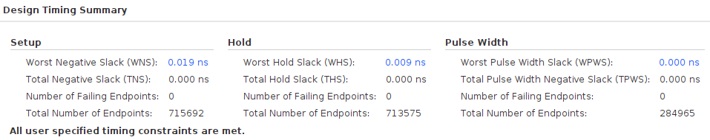
Timing Summary
The Worst Negative Slack (WNS) is 0.019ns at an operating Time Period of 3.33ns. Therefore, the Maximum Operating Frequency can be calculated as:
fmax = 1 / (3.33ns − 0.019ns) = 1 / 3.311 = 302.023MHz.
Figure 27: Timing summary.

Slide 40
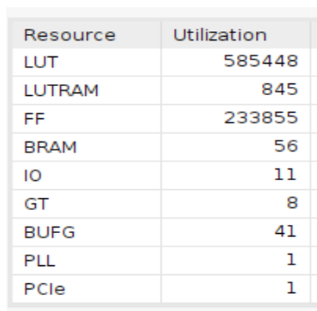
Comparison with previous implementations
Figure 28: Utilization report for previous design.
Figure 29: Utilization report of our design.

Slide 41
Comparison with previous implementations
 | Previous design | Implemented design
Methodology | Low level, using Verilog | High level, using C++
FPGA used | Virtex UltraScale+ | VCU118 | XCU50 (UltraScale+ architecture)
Utilization | Optimized for 64 | Optimized for any length
Input sequence Length | 64 | Any length
Max frequency of operation | 25.94 MHz | 302.023 MHz
User Interaction | CLI | CLI and GUI
Parallelism | One 64-unit | Four 64-units with iterations
Design parameters | Hard to tweak | Easy to tweak
Table 5: Comparision with previous implementations.

Slide 42
Future scope
Improvements in alignment algorithm for enhanced accuracy and speed.
Support for large-scale genomics pipelines via parser automation and integration with genomic databases (e.g., NCBI).
Dynamic kernel scaling to adapt compute resources based on sequence length or system load.
Multi-FPGA support enabling scaling and inter-FPGA communication for ultra-large datasets.
Integration with AI/ML models for predictive genomics and adaptive alignment scoring.
Multi-user access support for shared applications.
GUI enhancements for visual alignment insights and real-time progress tracking.
Extended compatibility with various sequence formats (FASTA, FASTQ etc).
Energy-efficient optimization for low-power FPGA deployment for portability.
Real-time error correction and quality scoring during alignment.

Slide 43
References
An Improved Algorithm for Matching Biological Sequences. Journal of Molecular Biology, 1982.
Fast gap-affine pairwise alignment using the wavefront algorithm.
An FPGA Accelerator of the Wavefront Algorithm for Genomics Pairwise Alignment. 31st International Conference on Field-Programmable Logic and Applications (FPL), 2021
An O(ND) Difference Algorithm and Its Variations.
Textbook, Bio informatics Sequence and Genome Analysis, David W. Mount University of Arizona, Tucson
DNA Sequencing
Optimal Gap-Affine Alignment in O(s) Space Bi-WFA Algorithm
Bioinformatics Algorithms : An Active Learning Approach
Vitis High Level Synthesis User Guide
Introduction to PCIe Interface

Slide 44
THANK YOU

Slide 45
Possible Questions

Slide 46
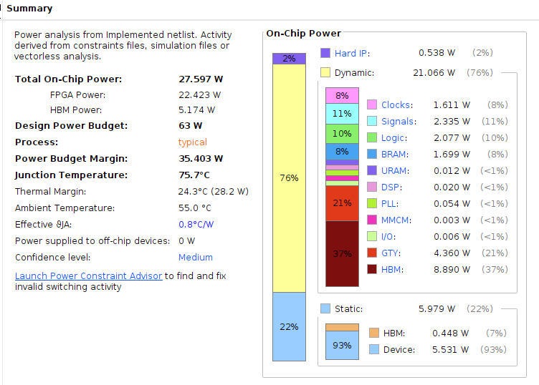
Power Summary (Typical)

Slide 47
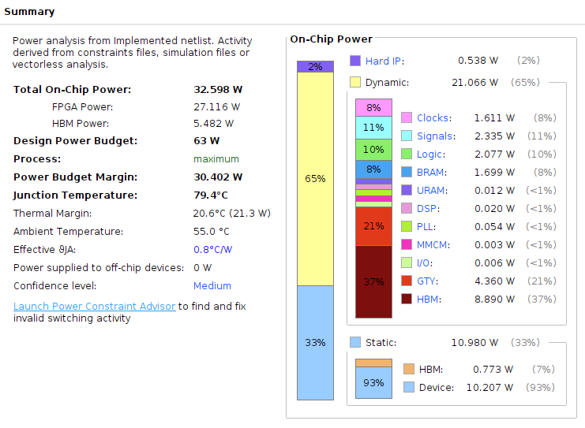
Power Summary (Maximum)

Slide 48
DNA vs RNA vs Proteins
Q) DNA vs RNA vs Proteins
DNA stores genetic information and codes our traits. DNA holds a vast library describing how the cell works. It is mostly inert which help it to serve as a static repository for information.
RNA acts to transfer certain short pieces of this library to different places in the cell, those smaller volumes of information are used as templates to synthesize proteins. RNA is more chemically active, and it usually lives in a single-stranded form.
Proteins form enzymes that perform biochemical reactions, send signals to other cells, form the body's major components.
The RNA carries short messages from the DNA to the cellular machinery that builds protein, and it can actively participate in important chemical reactions.
DNA ------------> RNA ------------> Proteins

Slide 49
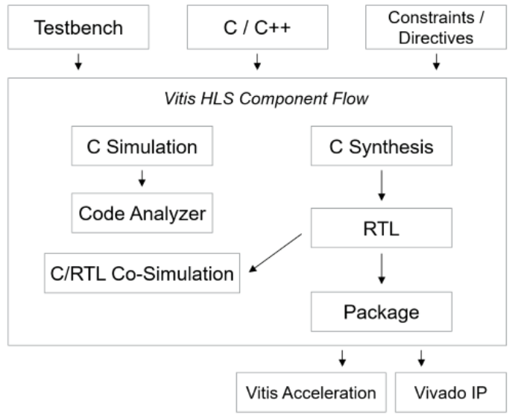
Vitis tool flow

Slide 50
MEM 2
Q) What do you mean by MEM 2 implementation and how you have done it?
While computing the scores of the DP Matrix, we have used only two columns and not the complete matrix which reduces the space complexity to O(n) from previous version i.e., O(nm).

Slide 51
HLS Vs Verilog
Q) Why is it better to use HLS than Verilog?
Sequence alignment algorithms often need frequent updates, tuning, or variant implementations (e.g., affine gap penalties, local vs global alignment).
Alignment algorithms involve many control structures (loops, conditionals), memory access, and complex data flow — all easier to express in C/C++ than RTL. HLS makes it easier to change algorithm parameters, data structures, or control logic without redesigning the RTL from scratch.
For Alveo U50, we typically have a heterogeneous compute model — a CPU host runs our application, and FPGA kernels accelerate compute-intensive parts. HLS fits naturally in this flow as we write kernels in C/C++ that compile to hardware IP, callable from host C++ code via XRT APIs. This makes it easier to build complex systems with both software and FPGA components without mixing languages and toolchains excessively.

Slide 52
Why individual HBM's?
Xilinx Alveo U50 offers up to 8GB HBM split into 32 pseudo-channels.
Each HBM channel on the U50 is physically 128 bits wide, but Xilinx exposes them as “pseudo‑channels,” splitting each physical channel into two logical banks. This gives 32 pseudo‑channels of 256 bits each. The split enables finer buffer partitioning and improved parallelism without changing physical bandwidth per port.
Each Alveo U50 HBM pseudo‑channel has its own 256‑bit bus and controller.
By isolating kernels to distinct channels, we achieve full 460 GB/s aggregate bandwidth. If two kernel inputs shared a channel, they’d contend for bus cycles, reducing sustained bandwidth per kernel by half and causing pipeline stalls in the HLS dataflow.
This design choice ensures high parallel throughput and minimizes memory bottlenecks.

Slide 53
Kernel Input with chunked sequence
Q) Chunking sequences strictly at fixed lengths (64 here) can cause boundary issues because optimal alignments can span chunk edges.
Approach:
Using a sliding window or k-mer overlap approach helps to smooth the boundaries by overlapping the chunks and reconciling overlaps. Instead of breaking sequence into non-overlapping chunks of length 64, we use overlapping chunks.
For example, if chunk size is 64 and overlap size is k (say 8 or 16 based on the read length), our chunks would be:
Chunk 1: seq[0:63] , Chunk 2: seq[64-k : 127-k], Chunk 3: seq[127-2k : 192-2k] and so on...
This way, each chunk overlaps with the previous chunk by k bases.
Find the best alignment breakpoint inside the overlap where both chunks can be joined optimally. Merge chunk alignments using this breakpoint.

Slide 54
Why Base length as 64
Biological Significance: Biologically, important features like motifs, exons, or conserved regions often span 30–100 base pairs. Very small chunks (e.g., <32 bp) may miss meaningful alignments or split important regions.
Hardware Resource Constraints (U50): 64 bp chunks → fast, fits comfortably in BRAM, allows multiple kernels.
Calculations: We have calculated the performance of alignment for various lengths(64,128,256) and observed that it performed better for length of 64.

Slide 55
Why Alveo U50
Q) Why Alveo U50 Is a Strong Choice for Sequence Alignment?
The core of alignment algorithms is a 2D dynamic programming matrix. FPGAs like the U50 can instantiate hundreds or thousands of parallel processing elements (PEs) for array computation.
The U50 provides enough LUTs, BRAM, and DSPs to parallelize and pipeline recursive computation.
Dynamic programming algorithms require frequent, random-access reads/writes to large scoring matrices. HBM2 enables parallel access patterns that reduce latency and improve throughput. Contrast this with other FPGAs (e.g., those with DDR4), which typically offer lower bandwidth and higher latency.
At only 75W, U50 can be used in standard servers and edge data centers without special cooling.
Proven in bioinformatics, AI inference, and high-frequency trading, making it trustworthy for high-accuracy, low-latency computation.

Slide 56
Utilization summary
LUTRAM: A portion of LUTs can be configured as small distributed RAM. We use LUTRAM for tiny on‑the‑fly FIFOs, control/status registers, and small lookup tables, but most bulk buffers are in BRAM/URAM.
URAM: UltraRAM (288 Kb each) provides large, single‑port or true dual‑port on‑chip memory. We only use a few URAM blocks for the largest buffers (e.g., full-chunk storage) to minimize off‑chip traffic.
GT: GTH/GTY transceivers handle high‑speed serial links (e.g., PCIe×16). On U50, 16 lanes are used for the PCIe interface, leaving only 4 unused. hence 80 % utilization.
PCIe: PCIe endpoint blocks on the FPGA. U50 exposes up to 5 endpoints; we use one for the host‑FPGA data transfers.

Slide 57
CPU vs GPU vs FPGA
Metric | CPU | GPU | FPGA
Performance | Moderate | High for data‑parallel | High for custom pipelines
Latency | Medium (µs–ms) | Medium (µs) | Low (ns–µs)
Power Efficiency | Low | Medium | High
Cost | Cheap to start, adds up | Costs more | Expensive at first, worth it over time
Flexibility | Highest general purpose | Good for parallel math | Highest hardware control
Build Time | Quick to develop | Takes more time | Takes longest (but tools help)
Availability | Found everywhere | Widespread | Less common, more specialized

Slide 58
Why only PCIe
Q) Why only PCIe why not UART or anything else?
Bandwidth Requirements: DNA sequence alignment transfers large data volumes (potentially gigabytes), and PCIe ×16 Gen3 on Alveo U50 delivers up to ~64 GB/s raw (≈32 GB/s effective) bandwidth. UART tops out at a few megabits per second—thousands of times too slow.
Latency and Efficiency: PCIe supports large, block‐oriented DMA transfers with very low per‐transfer overhead, whereas UART is byte‐oriented, interrupt‐driven, and incurs high CPU load for each byte.
Standard FPGA Ecosystem: Alveo cards come with built‑in PCIe endpoints and driver support (XRT), making integration and driver maintenance straightforward. Adding a custom high‑speed serial link would require extra PHYs, board redesign, and custom drivers.
Protocol Features: PCIe offers transaction ordering, error correction, flow control, and scatter‑gather DMA, all vital for robust, high‑throughput data movement

Slide 59
AXI vs PCIe
Feature | AXI (On-chip) | PCIe (Host ↔ FPGA)
Type | Parallel, memory-mapped bus | High-speed serial communication
Use Case | Internal FPGA data transfer | Host-FPGA data transfer via DMA
Latency | Very Low (ns) | Higher (μs, with protocol overhead)
Bandwidth | High (depends on bus width) | Very High (multi-GB/s with Gen3/Gen4)
Direction | FPGA internal (IP ↔ memory/kernels) | Bidirectional (Host ↔ FPGA)
Role in Project | Interconnect inside FPGA kernel designs | Used for transferring input/output data

Slide 60
DMA via PCIe
The host calls xrt::bo to allocate a buffer object. Under the hood, XRT allocates pinned (non‑swappable), page‐aligned host RAM and registers it with the PCIe NIC’s IOMMU.
The host maps the buffer into its address space, writes or “memcpy”s sequence data into it, then calls bo.sync(XCL_BO_SYNC_BO_TO_DEVICE).
That sync call invokes the XRT driver, which programs the PCIe DMA engine on the Alveo card with the physical addresses of the host buffer.
The FPGA’s DMA engine issues PCIe Memory Read TLPs (Transaction Layer Packets) to pull data from host RAM into the card’s receive buffer. Received data is written directly into the assigned HBM pseudo‑channel via the AXI interconnect—no CPU intervention.
Once the DMA completes, the FPGA kernel reads the data from HBM, performs the alignment, and writes results back into a second xrt::bo buffer in HBM.
The host calls bo.sync(XCL_BO_SYNC_BO_FROM_DEVICE), programming the DMA engine to perform Memory Write TLPs that push the result buffer from HBM back into registered host RAM.
The sync call blocks until the write‐back completes. The host can then read the aligned output directly from its buffer. This DMA‐based PCIe approach offloads all data‐movement tasks to the FPGA’s DMA engines and PCIe hardware, ensuring maximum throughput with minimal CPU overhead.

